Slide 1
Software System Requirements
Non-functional Requirements

Slide 2
Objectives
To introduce non-functional requirements
To explain the schemes used to classify non-functional requirements
To illustrate various derivation techniques for non-functional requirements
To demonstrate the importance of non-functional requirements in critical systems

Slide 3
Non-functional requirements (NFR)
Non-functional requirements define the overall qualities or attributes of the resulting system
Non-functional requirements place restrictions on the product being developed, the development process, and specify external constraints that the product must meet.
Examples of NFR include safety, security, usability, reliability and performance requirements.

Slide 4
Functional and Non-functional requirements
There is no a clear distinction between functional and non-functional requirements.
Whether or not a requirement is expressed as a functional or a non-functional requirement may depend:
  on the level of detail to be included in the requirements document
  the degree of trust which exists between a system customer and a system developer.

Slide 5
Example
The system shall ensure that data is protected from unauthorised access.
  Conventionally, this would be considered as a non-functional requirement because it does not specify specific system functionality which must be provided. However, it could have been specified in slightly more detail as follows:
  The system shall include a user authorisation procedure where users must identify themselves using a login name and password. Only users who are authorised in this way may access the system data.
  In this form, the requirement looks rather more like a functional requirement as it specifies a function (user login) which must be incorporated in the system.

Slide 6
Types of Non-functional requirements
The ‘IEEE-Std 830 - 1993’ lists 13 non-functional requirements to be included in a Software Requirements Document.
  Performance requirements
  Interface requirements
  Operational requirements
  Resource requirements
  Verification requirements
  Acceptance requirements

Slide 7
Types of NFRs (contd.)
  Documentation requirements
  Security requirements
  Portability requirements
  Quality requirements
  Reliability requirements
  Maintainability requirements
  Safety requirements

Slide 8
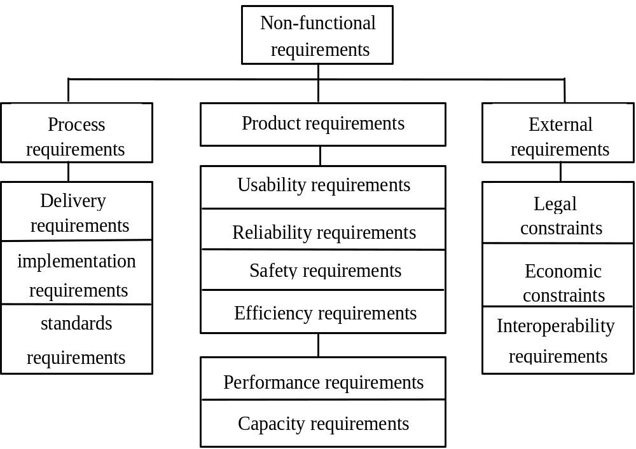
Classification of NFRs

Slide 9
Product requirements
Specify the desired characteristics that a system or subsystem must possess.
Most NFRs are concerned with specifying constraints on the behaviour of the executing system.
Some product requirements can be formulated precisely, and thus easily quantified
  Performance
  Capacity
Others are more difficult to quantify and, consequently, are often stated informally
  Usability

Slide 10
Examples of product requirements
The System service X shall have an availability of 999/1000 or 99.9%.
  This is a reliability requirement which means that out of every 1000 requests for this service, 999 must be satisfied.
System Y shall process a minimum of 8 transactions per second.
  This is a performance requirement.
The executable code of System Z shall be limited to 512Kbytes.
  This is a resource requirement which specifies the maximum memory size of the system.

Slide 11
Source code requirements
There are product requirements which relate to the source code of the system
Examples
  The system shall be developed for PC and Macintosh platforms. This is a portability requirement which affects the way in which the system may be designed
  The system must encrypt all external communications using the RSA algorithm. This is a security requirement which specifies that a specific algorithm must be used in the product

Slide 12
Conflicts in product requirements
Product requirements are often conflict. For example:
  A requirement for a certain level of performance may be contradicted by reliability and security requirements which use processor capacity to carry out dynamic system checking
  A requirement on the space utilisation of the system may be contradicted by another requirement which specifies that a standard compiler which does not generate compact code must be used
The process of arriving at a trade-off in these conflicts depends on:
  The level importance attached to the requirement
  The consequence of the change on the other requirements and,
  The wider business goals

Slide 13
Process requirements
Process requirements are constraints placed upon the development process of the system
Process requirements include:
  Requirements on development standards and methods which must be followed
  CASE tools which should be used
  The management reports which must be provided

Slide 14
Examples of process requirements
The development process to be used must be explicitly defined and must be conformant with ISO 9000 standards
The system must be developed using the XYZ suite of CASE tools
Management reports setting out the effort expended on each identified system component must be produced every two weeks
A disaster recovery plan for the system development must be specified

Slide 15
External requirements
May be placed on both the product and the process
Derived from the environment in which the system is developed
External requirements are based on:
  application domain information
  organisational considerations
  the need for the system to work with other systems
  health and safety or data protection regulations
  or even basic natural laws such as the laws of physics

Slide 16
Examples of external requirements
Medical data system The organisation’s data protection officer must certify that all data is maintained according to data protection legislation before the system is put into operation.
Train protection system The time required to bring the train to a complete halt is computed using the following function XYZ.
The first requirement described comes from the need for the system to conform to data protection legislation
The second comes from the application domain and is a specification of the physical braking characteristics of a train.
External requirements rarely have the form “the system shall...” or ‘the system shall not...”. Rather, they are descriptions of the system’s environment which must be taken into account.

Slide 17
Deriving NFRs
NFRs are difficult to express
A number of important issues contribute to the problem of expressing non-functional requirements:
  Certain constraints (e.g. response time to failure) are related to the design solution that is unknown at the requirements stage
  Certain constraints (e.g. human related ones) are highly subjective and can only be determined through complex empirical evaluations
  Non-functional requirements tend to be related to one or more functional requirements
  Non-functional requirements tend to conflict and contradict
  There are no ‘universal’ rules and guidelines for determining when non-functional requirements are optimally met.

Slide 18
Stakeholder concerns
Stakeholders normally have a number of ‘concerns’
Concerns are typically non-functional
Examples include:
  Critical business objectives
  Essential system characteristics (e.g. security)
  Safety, performance, functionality and maintainability
Vaguely defined user concerns may be related to NFRs

Slide 19
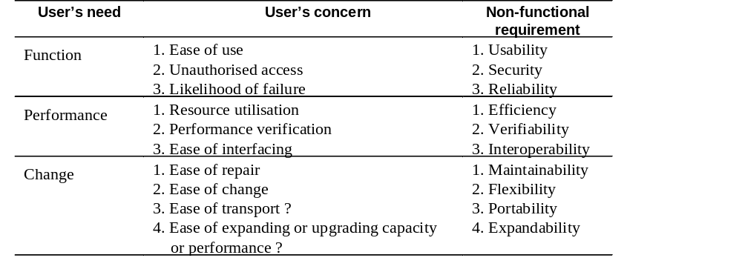
Relationships between user needs, concerns and NFRs

Slide 20
Concerns
A way of expressing critical ‘holistic’ requirements
Concerns may be broken down into sub-concerns and finally into specific questions
Questions act as a check list to ensure that specific requirements do not conflict with global priorities

Slide 21
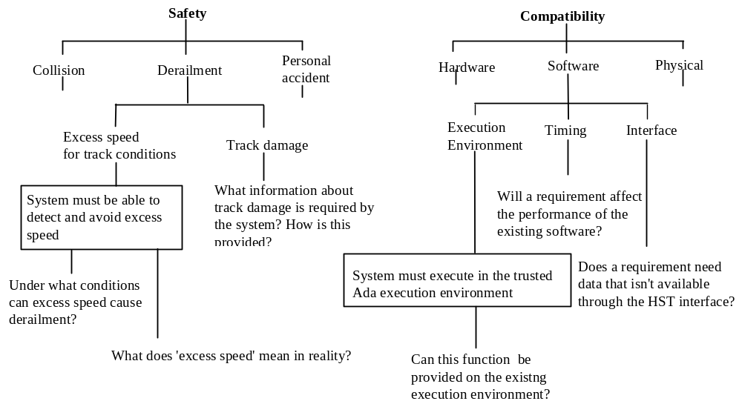
Concern decomposition

Slide 22
Goal-based derivation
Relates non-functional requirements to the goals of the enterprise
Goal-based NFR derivation is a 3 step approach:
  Identify the enterprise goal
  Decompose of the goal into sub-goals
  Identify non-functional requirements.

Slide 23
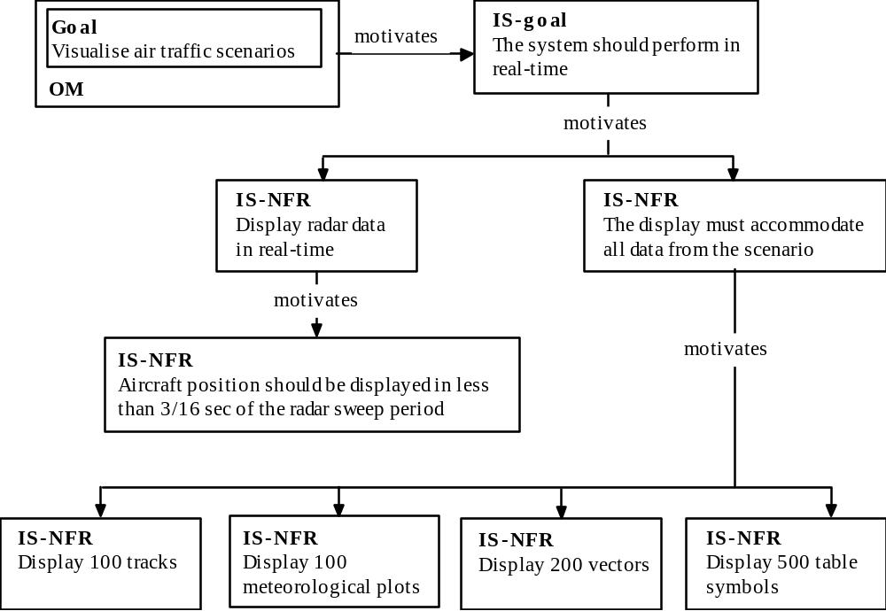
Example of goal-based derivation

Slide 24
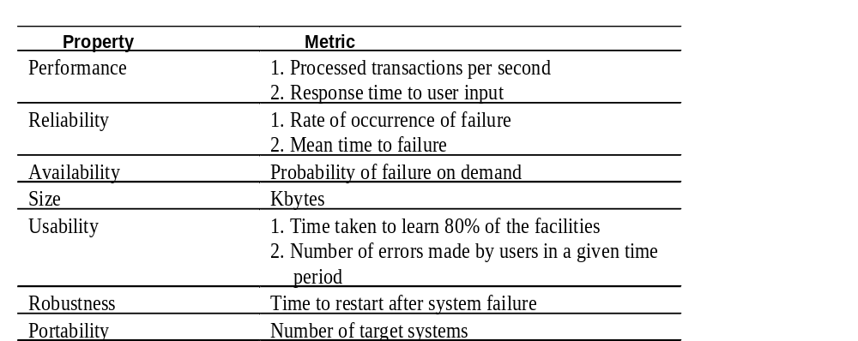
Examples of measurable metrics for NFRs

Slide 25
Requirements for critical systems
Systems whose ‘failure’ causes significant economic, physical or human damage to organisations or people.
There are three principal types of critical system:
  Business critical systems
  Mission critical systems
  Safety critical systems

Slide 26
NFRs for critical systems
The principal non-functional constraints which are relevant to critical systems:
  Reliability
  Performance
  Security
  Usability
  Safety

Slide 27
Reliability
Constraints on the run-time behaviour of the system
Can be considered under two separate headings:
  Availability - is the system available for service when requested by end-users.
  Failure rate - how often does the system fail to deliver the service expected by end-users.

Slide 28
Performance
Constrain the speed of operation of a system
Types of performance requirements:
  Response requirements
  Throughput requirements
  Timing requirements

Slide 29
Security
Security requirements are included in a system to ensure:
  Unauthorised access to the system and its data is not allowed
  Ensure the integrity of the system from accidental or malicious damage
Examples of security requirements are:
  The access permissions for system data may only be changed by the system’s data administrator
  All system data must be backed up every 24 hours and the backup copies stored in a secure location which is not in the same building as the system
  All external communications between the system’s data server and clients must be encrypted

Slide 30
Usability
Concerned with specifying the user interface and end-user interactions with the system
Well structured user manuals, informative error messages, help facilities and consistent interfaces enhance usability

